Slide 1
EXPOSING THE APIS OF INVISIBLE THINGS
Kati London, Etech 2008

Slide 2
Hackers and Artists Represent
The 1 Finger Salute

Slide 3
Artists use paintbrushes…today’s paintbrushes are technology…
Hardware/Software + Conceptualization

Slide 4
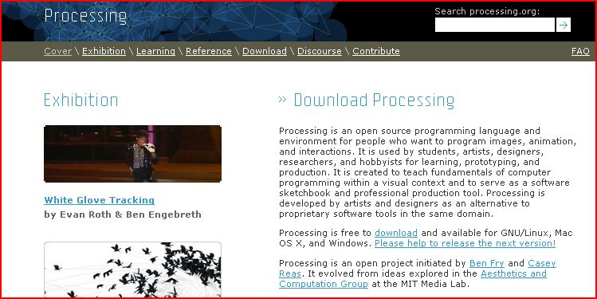
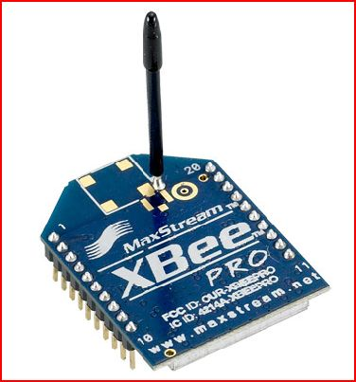
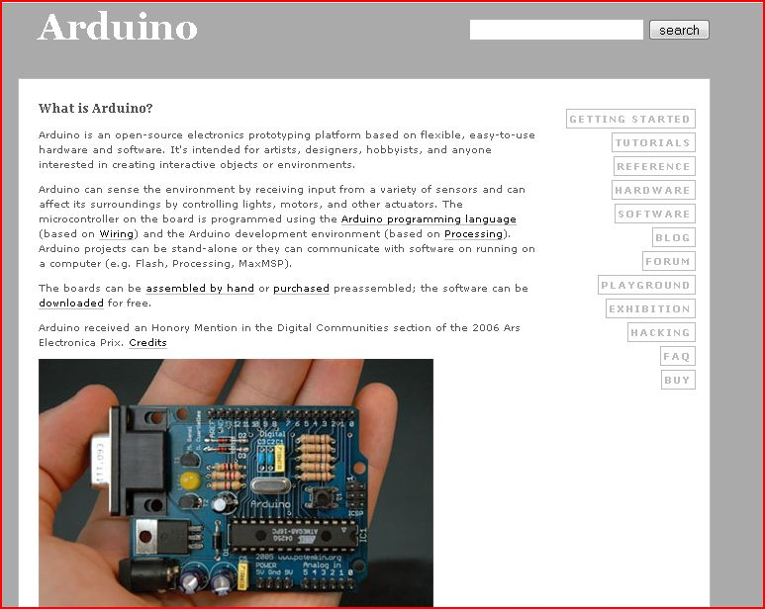

New Paintbrush Manufacturers

Slide 5
Ecological
Social
Spatial
Political
Network activity-based
Inter-species
…

Slide 6
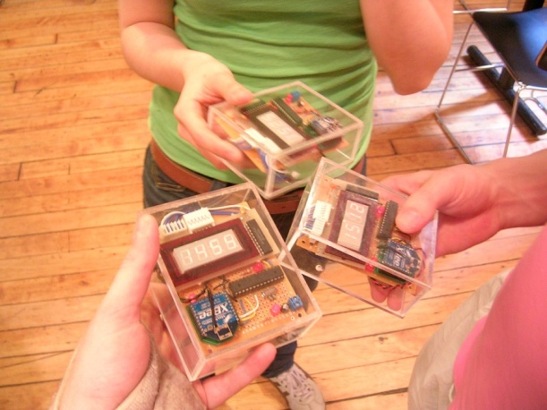

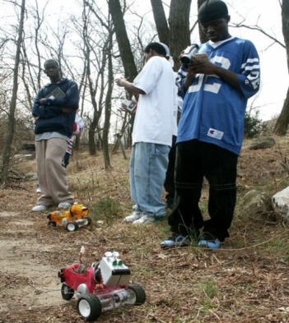
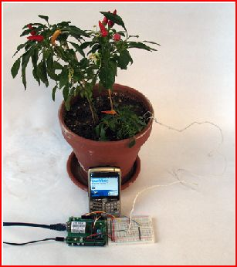
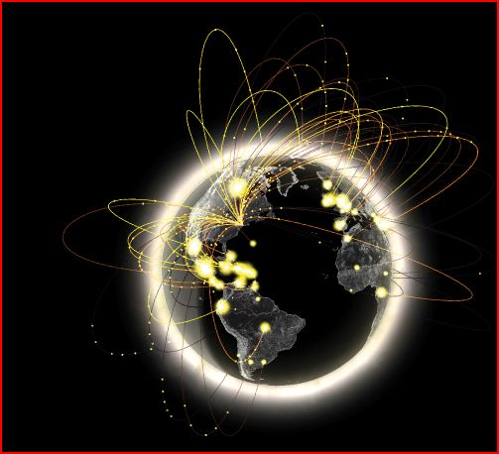
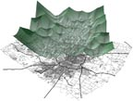
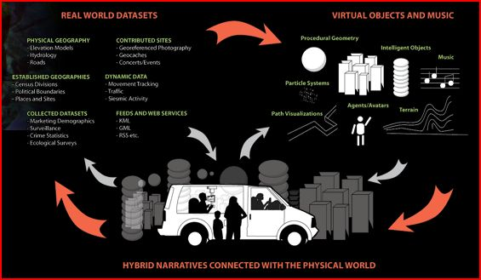
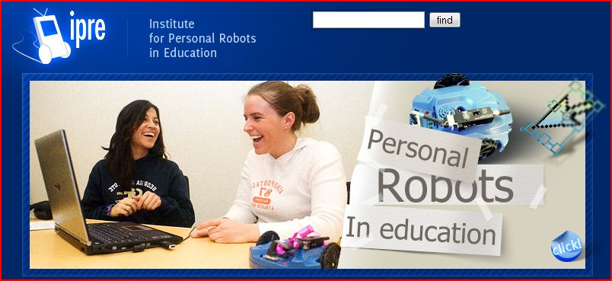
Social Bomb
Natalie Jeremijenko
Brooke Singer
MIT Senseable Media Group
Wifi Geography: Paul Torrens
Botanicalls
Twitter
Datascapes
IPRE

Slide 7
Invisible: Waste Processes

Slide 8
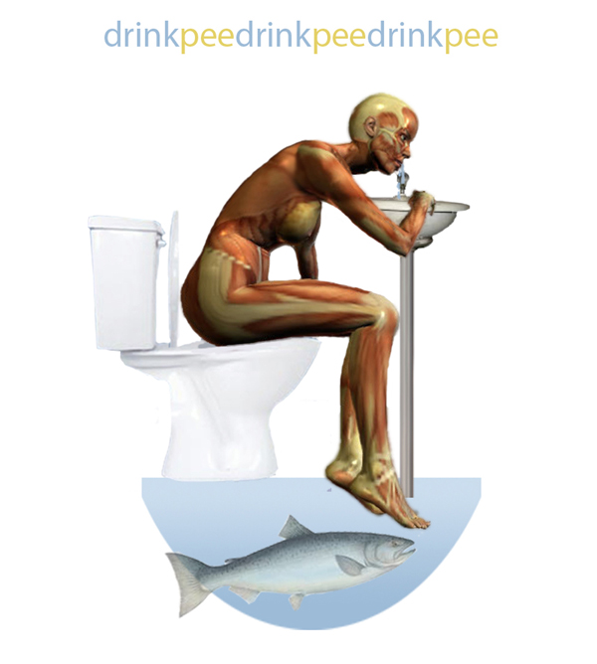
Rebecca Bray and Britta Riley

Slide 9
What happens when we think of our bodies as their own ecosystems?
Are they open or closed ecosystems?
Where do we draw the boundaries?

Slide 10

http://www.submersibledesign.com/drinkpee/

Slide 11
Invisible: Animal Behavior Patterns

Slide 12
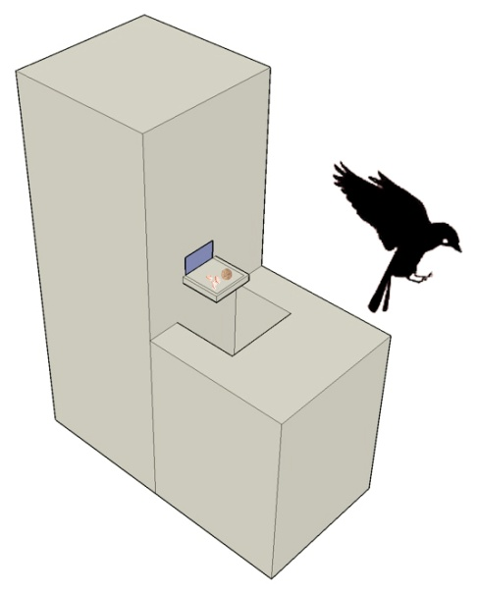
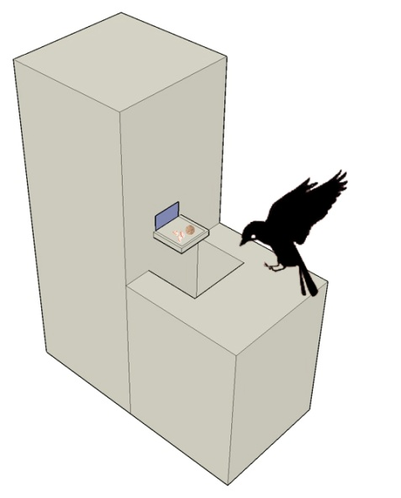
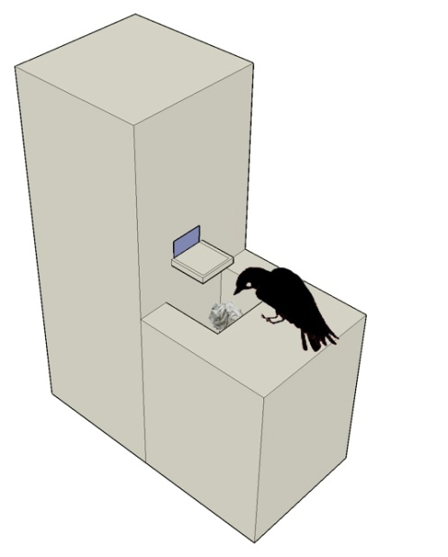

Joshua Klein, A Vending Machine for Crows

Slide 13
Mutually beneficial synanthropy, or the concept that we can have mutually beneficial relationships with animals adapted to human ecologies.

Slide 14
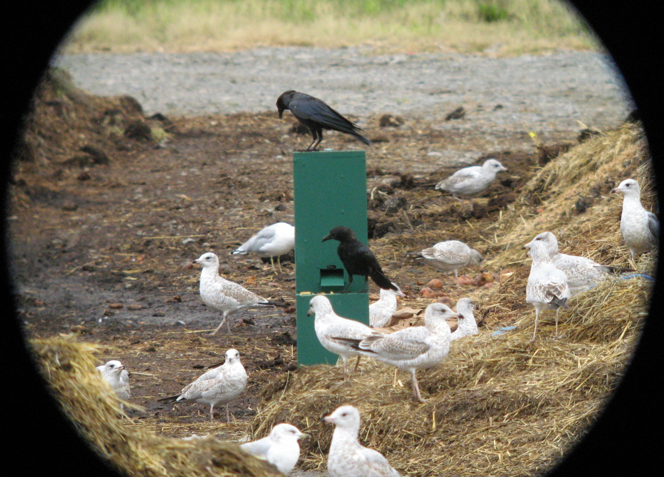
An Experiment in Corvid Learning and Resource Acquisition Strategy Transmission

Slide 15
Food and Coins Available Upon Departure
The device pushes a few peanuts and one or two coins onto the feeder tray whenever a crow *leaves* the device. This ensures that the device always has food whenever it is examined by a potential feeding crow. It also ensures that both the sound of the device and its mechanical operation occur in close proximity to the feeding act so as to acclimate the crow. By having this noise occur as the crow leaves it prevents startling a potential feeder away from using the device.

Slide 16
Food and Coins Available on Landing
Food and coins are issued when a crow arrives. At this point the crow should be comfortable with the sound of the device and is now being trained to wait for its reward when arriving at the machine. Note that the feeding tray is slanted such that coins will pile up and prevent peanuts from being available until the crow cleans them away - a typical behavior of crows is to sweep things out of the way with their beak, and in this case this causes the coins to fall down the funnel. This should help reinforce the connection between coins going down the funnel and peanuts being produced.

Slide 17
Coins Available on Landing/
Food Available on Departure
Coins alone are made available whenever the bird lands on the perch. However, should a bird peck or sweep coins off the tray and cause a coin to fall down the funnel, the device then produces some peanuts. This stage is designed to cement in the crows' mind the relationship between coins going down the funnel and peanuts being made available.

Slide 18

Food Available on Coin Deposit
Long-term state only provides peanuts when coins go down the funnel. Nothing is otherwise provided aside from coins scattered around the device at the beginning of the project.

Slide 19
Invisible: Social Connections

Slide 20
Exposing the vulnerabilities of the network…
Bluetooth snarfing shared address book transfer your calls around an infinite loop of strangers.

Slide 21
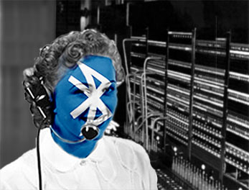
Generative Social Networking
Andrew Schneider and Christian Croft

Slide 22
EXPOSING THE APIS OF INVISIBLE THINGS
Kati London, Etech 2008

